Slide 1

Data Science with Python
Lesson 3 – Statistical Analysis and Business Applications

Slide 2



What You’ll Learn
The difference between statistical and non-statistical analysis
The two major categories of statistical analysis and their differences
The statistical analysis process
Mean, median, mode, and percentile
Data distribution and the various methods of representing it
Hypothesis testing and the Chi square test
Types of frequencies
Correlation matrix and its uses

Slide 3


Introduction to Statistics
Statistics is the study of the collection, analysis, interpretation, presentation, and organization of data.
Well-informed decision
PROBLEMS SOLVED
DATA
COMPLEX PROBLEMS

Slide 4
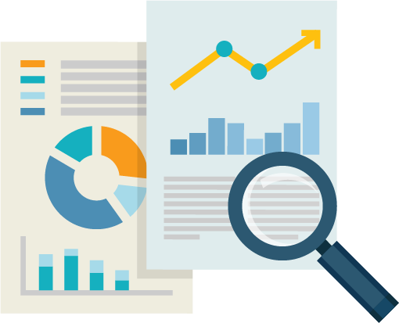

Introduction to Statistics
Statistics is the study of the collection, analysis, interpretation, presentation, and organization of data.
Tools available to analyze data:
Statistical principles
Functions
Algorithms
What you can do using statistical tools:
Analyze the primary data
Build a statistical model
Predict the future outcome

Slide 5



Statistical and Non-statistical Analysis
Statistical Analysis
Non-statistical Analysis
Statistical Analysis is:
scientific
based on numbers or statistical values
useful in providing complete insight to the data
Non-statistical Analysis is:
based on very generic information
exclusive of statistical or quantitativ
Although both forms of analysis provide results, quantitative analysis provides more insight and a clearer picture. This is why statistical analysis is important for businesses.

Slide 6

Major Categories of Statistics
There are two major categories of statistics: Descriptive analytics and inferential analytics
Descriptive analysis organizes the data and focuses on the main characteristics of the data.
HIGH
MEDIUM
MATH SCORES
NUMBER OF STUDENT
1 8 4 7 3 6 9 2 5 0
LOW
0
1
2
3
4
5
6
7
8
9
LOW
MEDIUM
HIGH

Slide 7


Major Categories of Statistics
Inferential analytics uses the probability theory to arrive at a conclusion.
Random sample is drawn from the population
Used to describe and make inferences about the population
Inferential analytics is valuable when it is not possible to examine each member of the population.

Slide 8

Major Categories of Statistics – An Example
Study of the height of the population
Tall
Inferential Method
Medium
Categorize height as “Tall,” “Medium,” and “Short” Take a sample to study from the population.
Short
Descriptive Method
Record the height of each and every person. Provide the tallest, shortest, and average height of the population.

Slide 9


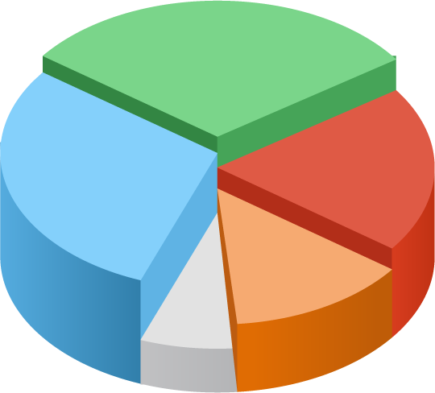

Statistical Analysis Considerations
Purpose
Clear and well-defined
Document Questions Prepare a questionnaire in advance
Define Population of Interest
Select population based on the purpose of analysis
Determine Sample Based on the purpose of study

Slide 10
Population and Sample
A population consists of various samples. The samples together represent the population.
A sample is:
The part/piece drawn from the population
The subset of the population
A random selection to represent the characteristics of the population
Representative analysis of the entire population

Slide 11
Statistics and Parameters
“Statistics” are quantitative values calculated from the sample. “Parameters” are the characteristics of the population.
Sample → Xo, X1,X2……….Xn
 | Population Parameters | Sample Statistics | Formula
Mean | µ | x | x = ¹ ∑ _{x} _{n} i
Variance | _{σ}2 | _{S} 2 | _{S}² = ¹ ∑( _{x} − x ² n −1 ^{i )}
Standard Deviation | σ | S | S = ¹ ∑( _{x} − x ₎² n −1 ^{i}

Slide 12

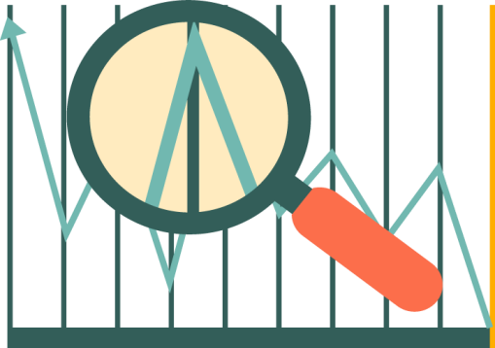
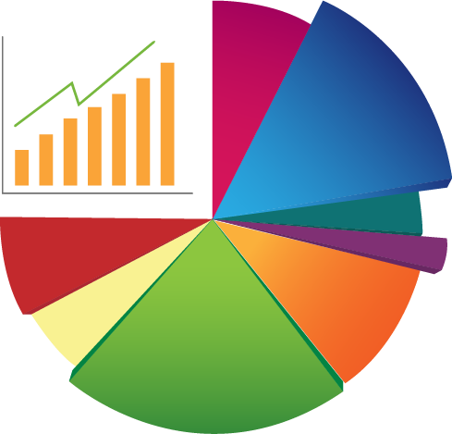

Terms Used to Describe Data
Typical terms used in data analysis are:
SEARCH
“Search” is used to find unusual data. Data that does not match the parameters.
INSPECT
“Inspect” refers to studying the shape and spread of data.
CHARACTERIZE
“Characterize” refers to determining the central tendency of the data.
CONCLUSION
“Conclusion” refers to preliminary or high- level conclusions about the data.

Slide 13
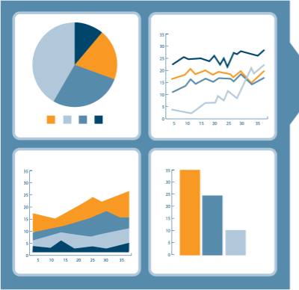
Statistical Analysis Process
There are four steps in the statistical analysis process.
Step 1: Find the population of interest that suits the purpose of statistical analysis.
Step 2: Draw a random sample that represents the population.
Step 3: Compute sample statistics to describe the spread and shape of the dataset.
Step 4: Make inferences using the sample and calculations. Apply it back
to the population.

Slide 14
Data Distribution
The collection of data values arranged in a sequence according to their relative frequency and occurrences.
Range of the data refers to minimum and maximum values.
Frequency indicates the number of occurrences of a data value.
Central tendency indicates data accumulation toward the middle of the distribution or toward the end.
1.5
1
0
19.1% 19.1%
-0.5
-1
15.0%
15.0%
9.2%
9.2%
-1.5
4.4%
4.4%
1.7%
1.7%
-3 -2.5 -2 -1.5 -1 -0.5
0 0.5 1 1.5 2 2.5 3

Slide 15
Measures of Central Tendency
The measures of central tendency are Mean, Median, and Mode.
Mean is the average. Determine the mean score of these Math scores. 1. 80 2. 70 3. 75 4. 90 5. 80 6. 78 7. 55 8. 60 9. 80
Ʃ [80+70+75+90+80+78+55+60+80]/9
Mean = 74.22
Median is the 50th percentile. 55 60 70 75 78 80 80 80 90
Median = 78
Mode is the most frequent value. 55 60 70 75 78 80 80 80 90
Mode = 80

Slide 16
Percentiles in Data Distribution
A percentile (or a centile) indicates the value below which a given percentage of observations fall.
Observations
98
95
92
90
85
81
79
70
63
55
47
42
75th percentile =91
Third Quartile
50th percentile =80
25th percentile =59
Second Quartile or Median
First Quartile

Slide 17
Dispersion
Dispersion denotes how stretched or squeezed a distribution is.
Observations
98
95
92
75th percentile = 91
Range: The difference between the maximum and minimum values
Inter-quartile Range: Difference between the 25th and 75th percentiles
Variance: Data values around the Mean. (74.75)
Standard Deviation: Square root of the variance measured in small units
90
85
81
50th percentile = 80
79
70
63
25th percentile = 59
55
47
42

Slide 18

Knowledge Check

Slide 19


KNOWLEDGE CHECK
What does frequency indicate?
a. Range of the values present in the dataset
b.
Number of occurrences of a particular value in a dataset
c.
How spread out the data is
d. Size of the sample drawn from a population

Slide 20

KNOWLEDGE
CHECK
What does frequency indicate?
a.
Range of the values present in the dataset
b.
Number of occurrences of a particular value in a dataset
c.
How spread out the data is
d.
Size of the sample drawn from a population
The correct answer is
_{b} .
Explanation: Frequency indicates the number of occurrences of a particular value in a dataset.

Slide 21
Histogram
Graphical representation of data distribution
Features of a Histogram:
It was first introduced by Karl Pearson.
To construct a Histogram, “bin” the range of values.
Bins are consecutive, non-overlapping intervals of a variable.
Bins are of equal size.
The bars represent the bins.
The height of the bar represents the frequency of the values in the bin.
It helps assess the probability distribution of a variable.
5.0
4.0
Frequency
3.0
2.0
1.0
0
20 30 40 50 60 70 80 90 100
Age
bin

Slide 22
Bell Curve – Normal Distribution
The bell curve is characterized by its bell shape and two parameters, mean and standard deviation.
Normal Curve
Bell curve is:
Standard Deviation
Mean
Symmetric around the mean,
Symmetric on both sides of the center,
Having equal mean, median, and mode values,
Denser in the center and less dense in the tails or sides,
Dense
Defined by mean and standard deviation, and
Known as the “Gaussian” curve.
19.1% 19.1%
tails
15.0%
15.0%
tails
0.1% 0.5%
9.2%
9.2%
0.5% 0.1%
1.7%
4.4%
4.4%
1.7%
-3 -2.5 -2 -1.5 -1 -0.5
0 0.5 1 1.5 2 2.5 3
The Bell curve is fully characterized by the mean (μ) and standard deviation (σ).

Slide 23
The Bell Curve
The Bell curve is divided into three parts to understand data distribution better.
Peak
Peak = Within one standard
deviation from the mean
Flanks
Flanks = Between one and two
standard deviations from the mean
Tail
Tail = Beyond two standard
deviations from the mean

Slide 24
Bell Curve – Left Skewed
Skewed data distribution indicates the tendency of the data distribution to be more spread out on one side.
Left Skewed
The data is left skewed.
Mean < Median
The distribution is negatively skewed.
Left tail contains large distributions.
80
70
60
50
40
30
20
10
0
Frequency
1 2 3 4 5 6 7 8
9 10 11 12 13
Measurement

Slide 25
Bell Curve – Right Skewed
Skewed data distribution indicates the tendency of the data distribution to be more spread out on one side.
Right
The data is right skewed.
The distribution is positively skewed.
Mean > Median
Right tail contains large distributions.
80
70
60
50
40
30
20
10
0
Skewed
Frequency
1 2 3 4 5 6 7 8
9 10 11 12 13
Measurement

Slide 26
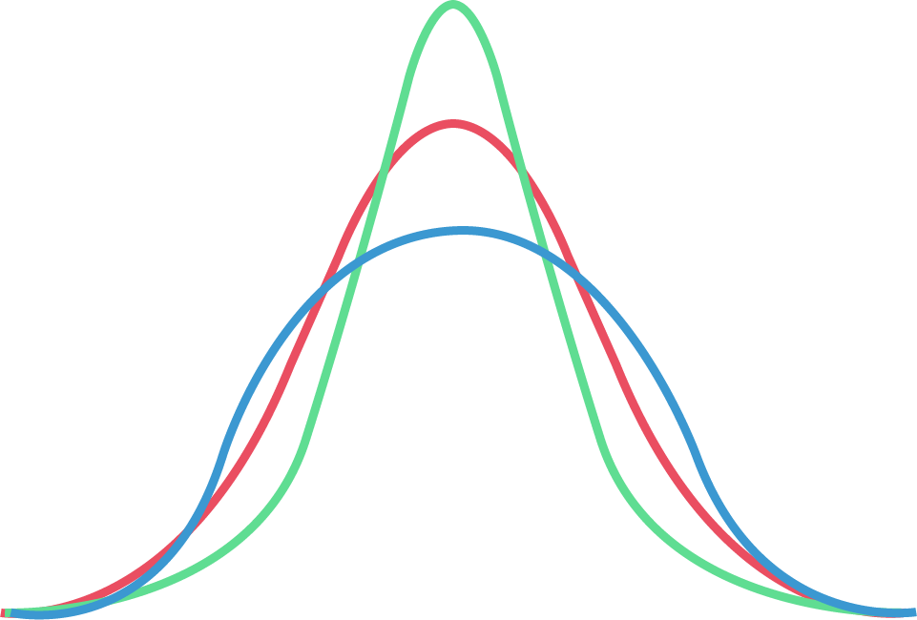
Kurtosis
Kurtosis describes the shape of a probability distribution.
There are:
• Different ways of quantifying a theoretical distribution.
• Corresponding ways of estimating it from a sample of population.
Kurtosis measures the tendency of the data toward
the center or toward the tail.
Platykurtic is negative kurtosis.
(+) Leptokurtic
(0) Mesokurtic (Normal)
Mesokurtic represents a normal distribution curve.
Leptokurtic is positive kurtosis.
(-) Platykurtic

Slide 27
Knowledge Check

Slide 28
KNOWLEDGE CHECK
Which of the following is true for a normal distribution?
a. Mean and median are equal
b.
Mean and mode are equal
c.
Mean, median, and mode are equal
d. Mode and median are equal

Slide 29
KNOWLEDGE
CHECK
Which of the following is true for a normal distribution?
a.
Mean and median are equal
b.
Mean and mode are equal
c.
Mean, median and mode are equal
d.
Mode and median are equal
The correct answer is
. _{c}
Explanation: for Bell curve mean, median, and mode are equal.

Slide 30

Hypothesis Testing
Hypothesis testing is an inferential statistical technique that determines if a certain condition is true for the population.
Alternative Hypothesis (H1) | Null Hypothesis (H0)
A statement that has to be concluded as true. | A statement of “no effect” or “no difference”.
It’s a research hypothesis. | It’s the logical opposite of the alternative hypothesis.
It needs significant evidence to support the initial hypothesis. | It indicates that the alternative hypothesis is incorrect.
If the alternative hypothesis garners strong evidence, reject the null hypothesis. | Weak evidence of alternative hypothesis indicates that the null hypothesis has to be accepted.

Slide 31
Hypothesis Testing – Error Types
Representation of decision parameters using null hypothesis
Type I Error (α)
Rejects the null hypothesis when it is true
The probability of making Type I error is represented by
α
Type II Error (β)
Fails to Reject the null hypothesis when it false
The probability of making Type II error is represented by β
p-value
The probability of observing extreme values
Calculated from collected data
Decision | Ho is True | Ho is False
Fail to Reject Null | Correct | Type II Error
Reject Null | Type I Error | Correct

Slide 32
Hypothesis Testing - Process
There are four steps to the hypothesis testing process.
Step 4
Step 3
Make decision
p-value < α p-value ≥ α
Step 2
Collect Data Collect sample from population
Step 1
Set α Significant Level
Set α or choose the significant level for the population.
Set Hypothesis
H0 (μ₁ = μ₂) : Equality H1(μ₁ ≠ μ₂) : Difference
Reject the null hypothesis if p-value < α
Fail to reject the null hypothesis if p-value ≥ α

Slide 33


Perform Hypothesis Testing
An example of clinical trials data analysis.
Company A
Company B
Null Hypothesis: Both medicines are equally effective.
Alternative Hypothesis: Both medicines are NOT equally effective.

Slide 34

Data for Hypothesis Testing
There are three types of data on which you can perform hypothesis testing.
Continuous Data
Evaluate the mean, median, standard deviation, or variance.
Binomial Data
Evaluate the percentage, general classification of data.
Poisson Data
Evaluate rate of occurrence or frequency.

Slide 35




Types of Variables
There are three types of variables in categorical data.
Nominal Variables
Values with no logical ordering
Variables are independent of each other
Sequence does not matter
Ordinal Variables
Values are in logical order
Relative distance between two data values is not clear
85% | 15% | 68% | 32%
85% | 15% | 95% | 55%
Association
Two variables are associated or independent of each other.

Slide 36




Chi-Square Test
It is a hypothesis test that compares the observed distribution of your data to an expected distribution of data.
Test of Association:
To determine whether one variable is associated with a different variable. For example, determine whether the sales for different cellphones depends on the city or country where they are sold.
Test of Independence:
To determine whether the observed value of one variable depends on the observed value of a different variable. For example, determine whether the color of the car that a person chooses is independent of the person’s gender.
Test is usually applied when there are two categorical variables from a single population.

Slide 37
Chi Square Test - Example
An example of Chi-Square test.
Null Hypothesis
There is no association between gender and
purchase.
The probability of purchase does not change for 500 dollars or more whether female or male.
 | <$500 | >$500
fo | .55 | .45
fo | .75 | .25
Alternative Hypothesis
There is association between gender and
purchase.
The probability of purchase over 500 dollars is different for female and male.

Slide 38
Types of Frequencies
Expected and observed frequencies are the two types of frequencies.
Expected Frequencies (fe)
 | Purchases
 | <$500 | >$500
fo | .55 | .45
fo | .75 | .25
The cell frequencies that are expected in a bivariate table if the two tables are statistically independent.
Observed Frequencies (fo)
There is association between gender and purchase.
The probability of purchase over 500 dollars is different for female and male.
No Association
Observed Frequency = Expected Frequency
Association
Observed Frequency ≠ Expected Frequency

Slide 39
Features of Frequencies
The formula for calculating expected and observed frequencies using Chi Square:
∑( f_{e} − f_{o} )
2
f_{e}
Features of Expected and Observed frequencies:
Requires no assumption of the underlying population
Requires random sampling

Slide 40
Knowledge Check

Slide 41
KNOWLEDGE CHECK
In Chi-Square test, there is no association of variables if .
a. Observed Frequency ≠ Expected Frequency
b.
Observed Frequency = Expected Frequency
c.
Independent of observed frequencies
d. Independent of expected frequencies

Slide 42
KNOWLEDGE
CHECK
In Chi-Square test, there is no association of variables if:
a.
Observed Frequency ≠ Expected Frequency
b.
Observed Frequency = Expected Frequency
c.
Independent of observed frequencies
d.
Independent of expected frequencies
The correct answer is
b
.
Explanation: Observed Frequency = Expected Frequency indicates no association.

Slide 43
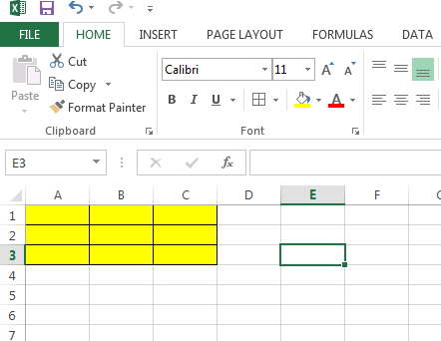
Correlation Matrix
A Correlation matrix is a square matrix that compares a large number of variables.
Correlation matrix – a square matrix n × n Matrix
(very large number of rows and columns)
(0,0) | (0,1) | (0,2)
(1,0) | (1,1) | (1,2)
(2,0) | (2,1) | (2,2)
Correlation coefficient measures the extent to which two variables tend to change together.
The coefficient describes both the strength and direction of
the relationship.
3 × 3 matrix (simple square matrix)

Slide 44
Correlation Matrix
A Correlation matrix is a square matrix that compares a large number of variables.
Pearson product moment correlation
It evaluates the linear relationship between two continuous variables.
Linear relationship means that a change in one variable results in a proportional change in the other.
Spearman rank order correlation
It evaluates the monotonic relationship between two continuous or ordinal
variables.
Monotonic relationship means that the variables tend to change together though not necessarily at a constant rate.
The correlation coefficient is based on the ranked values for each variable rather than the raw data.

Slide 45
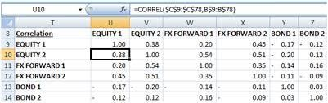

Correlation Matrix - Example
An example of a correlation matrix calculated for a stock market.
A correlation matrix that is calculated for the stock market will probably show the short-term,
medium-term, and long-term relationship between data variables.

Slide 46












Inferential Statistics
Inferential statistics uses a random sample from the data to make inferences about the population.
Inferential statistics can be used only under the following conditions:
A complete list of the members of the population is available.
A random sample has been drawn from the population.
Using a pre-established formula, you determine that the sample size is large enough.
Inferential statistics can be used even if the data does not meet the criteria.
It can help determine the strength of the relationships within the
sample.
If it is very difficult to obtain a population list and draw a random sample, do the best you can with what you have.

Slide 47
Applications of Inferential Statistics
Inferential Statistics has its uses in almost every field such as business, medicine, data science, and so on.
Inferential Statistics
Is an effective tool for forecasting.
Is used to predict future patterns.
120
100
80
60
40
20
0

Slide 48

Quiz

Slide 49
QUIZ 1
If a sample of five boxes weigh 90, 135, 160, 115, and 110 pounds, what will be the median weight of this sample?
a.
160
b.
115
c.
90
d.
135

Slide 50
QUIZ 1
If a sample of five boxes weigh 90, 135, 160, 115, and 110 pounds, what will be the median weight of this sample?
a.
160
b.
115
c.
90
d.
135
The correct answer is
b
.
Explanation: Arrange in a sequential order and the middle number will be the median. If the set of numbers is even then take the average or mean of the two numbers in the middle.

Slide 51
QUIZ 2
Identify the parameters that characterize a bell curve. Select all that apply.
a.
Variance
b.
Mean
c.
Standard deviation
d.
Range

Slide 52
Identify the parameters that characterize a bell curve. Select all that apply.
QUIZ 2
a.
Variance
b.
Mean
c.
Standard deviation
d.
Range
The correct answer is
b,c .
Explanation: Bell Curve is completely characterized by mean and standard deviation.

Slide 53
QUIZ 3
Identify the accurate statement about the relationship between standard deviation and variance.
a.
Standard deviation is the square root of variance.
b.
Variance is the square root of standard deviation.
c.
Both are inversely proportional.
d.
Both are directly proportional.

Slide 54
QUIZ 3
Identify the accurate statement about the relationship between standard deviation and variance
a.
Standard deviation is the square root of variance.
b.
Variance is the square root of standard deviation.
c.
Both are inversely proportional.
d.
Both are directly proportional.
The correct answer is
a.
Explanation: Standard deviation is the square root of variance.

Slide 55
QUIZ 4
Identify the hypothesis decision rules. Select all that apply.
a.
Reject the null hypothesis if p-value < α
b.
Is independent of p-value
c.
Fail to reject the null hypothesis if p-value ≥ α
d.
Is independent of α

Slide 56
Identify the hypothesis decision rules. Select all that apply.
QUIZ 4
a.
Reject the null hypothesis if p-value < α
b.
Is independent of p-value
c.
Fail to reject the null hypothesis if p-value ≥ α
d.
Is independent of α
The correct answer is
a, c .
Explanation: A hypothesis decision rule :
Reject the null hypothesis if p-value < α
Fail to reject the null hypothesis if p-value ≥ α

Slide 57




Key Takeaways
Statistics is the study of the collection, analysis, interpretation,
presentation, and organization of data.
Statistical analysis is more reliable when compared to non-statistical analysis.
Descriptive and inferential are the two major categories of statistics.
Mean, median, and mode are measures of central tendency, while variance
and standard deviation measure the spread of data.
The spread of distribution is called dispersion and is graphically represented by a histogram and a bell curve.
Hypothesis testing is an inferential statistical technique that is useful for
forecasting future patterns.
Chi-Square test is a hypothesis test that compares observed distribution to an expected distribution.
The correlation coefficient or covariance is measured with the help of correlation matrix.

Slide 58


This concludes “Statistical Analysis and Business Applications”
The next lesson is “Data Analytics Overview”

